Slide 1


Project on Exploratory Data Analysis and Predictive Modeling with Synthetic Splicing Dataset
BINF5040E001
Presented by
SAI PINKY SAMYUKTHA VELPURI

Slide 2
INTRODUCTION
Gene splicing is a critical biological process that occurs in eukaryotic cells to generate
functional messenger RNA (mRNA) molecules from the precursor RNA. The primary purpose
of gene splicing is to remove non-coding regions (introns) and join the coding regions (exons) to create a mature mRNA molecule that can be translated into a protein.
In this project, I worked with a synthetic dataset containing the expressions of three splicing factors and a related splicing event across 100 subjects. My objective is to perform exploratory data analysis (EDA), data visualisation, and predictive modelling to gain insights into the relationships between splicing factors and the splicing event.

Slide 3
TASKS
1. Data Exploration
2. Data Visualization
3. Predictive Modeling
4. Conclusions and Recommendations

Slide 4
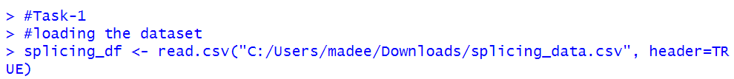
1. DATA EXPLORATION
Loading the Dataset
The dataset contains four features excluding the subject id.
The dimension of our dataset is (100,5).
It means we contain 100 instances of the data points and 5 features.

Slide 5
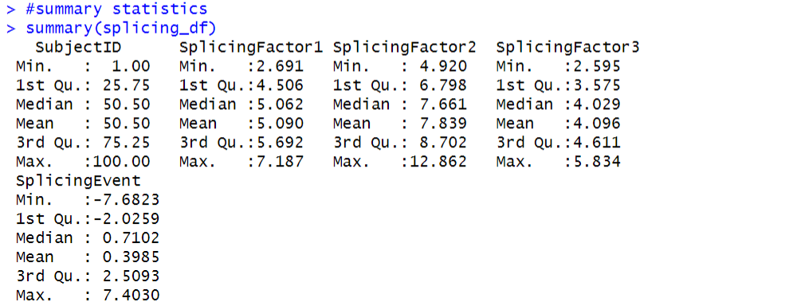
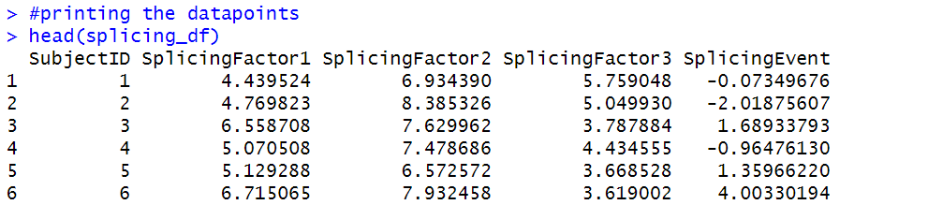
1. DATA EXPLORATION
Summary
For the splicing factors, the summary indicates the range of values they take, as well as their distribution across the dataset. For instance, the median values for SplicingFactor2 and SplicingFactor3 are around 5.062 and 7.661, respectively, indicating that these factors tend to have values around these points in the dataset.
The statistics for the SplicingEvent variable suggest its distribution and central tendency.
For example, the mean of 0.3985 suggests that, on average, the splicing event measure is close to zero, while the range of values (from -7.6823 to 7.4030) indicates the variability of this measure across the dataset.

Slide 6
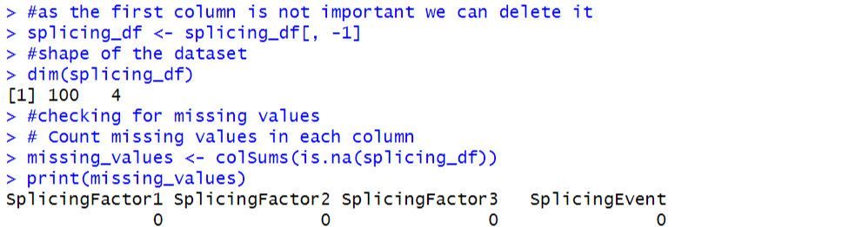
1. DATA EXPLORATION
Missing values
When we check the missing values we see that the Splicingfactor1,2,3,4 and Splicingevent are all 0. That means it doesn't contain any missing values.

Slide 7
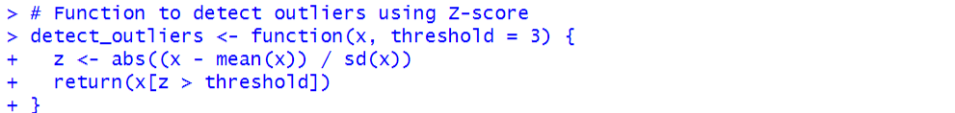
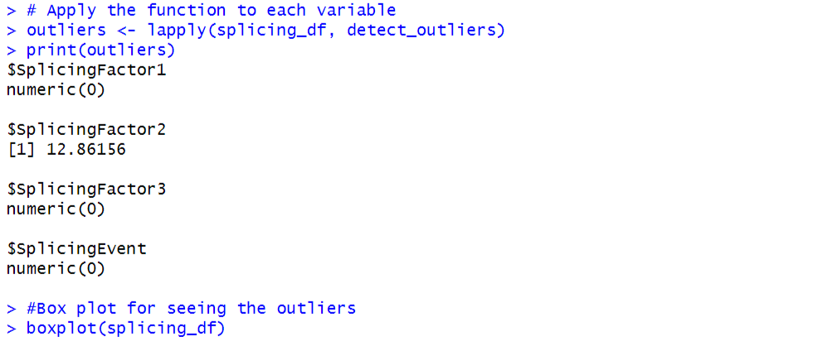
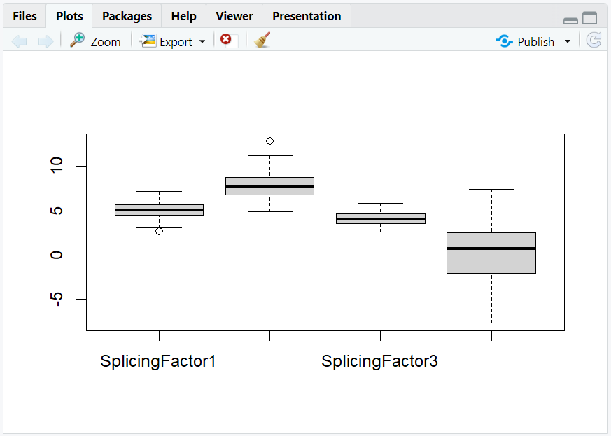
1. DATA EXPLORATION
Outliers
It means the data points are away from the normal distributions. If you train the model using it then we can get errors in the test case.
The following plot suggests that we have an outlier
only in the splicing factor2 column. Its value is
12.8615(there in the code file). This value is significantly
different from all the values present in that column of
the dataset.

Slide 8
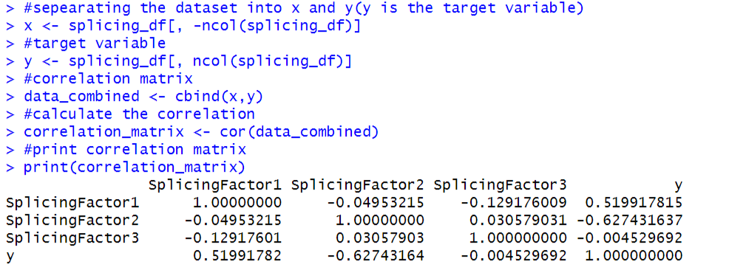
1. DATA EXPLORATION
Correlation matrix
It has a moderate positive correlation with "SplicingFactor1" (0.5199), indicating a positive relationship, and a moderate negative correlation with "SplicingFactor2" (-0.6274), indicating a negative relationship. The correlation with "SplicingFactor3" is very weak (- 0.0045), suggesting little to no relationship.
That is the splicing factor 1 is positively related to the target variable(splicing event). It means with an increase in the value of factor 1 simultaneously y value also increases.
Then, the other two features are negatively
related to the target variable

Slide 9
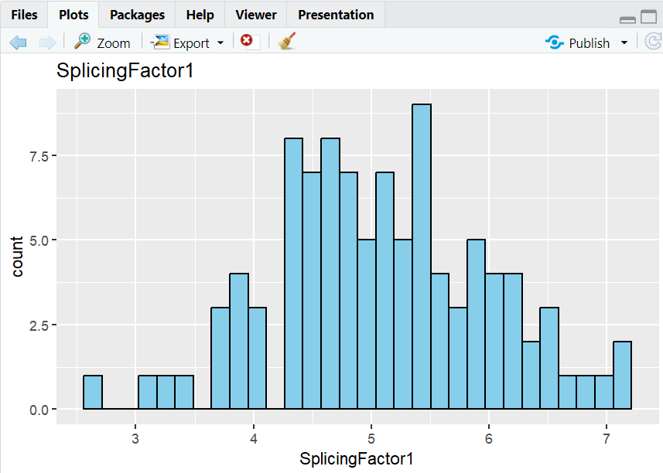
2. DATA VISUALIZATION
Here we created visualization to explore the distribution of each splicing factor
expressions and splicing events
This is a Histogram that shows the Distribution of splicingFactor1 features.
Here we can see that we have a greater count of splicing factor when its value increases.

Slide 10
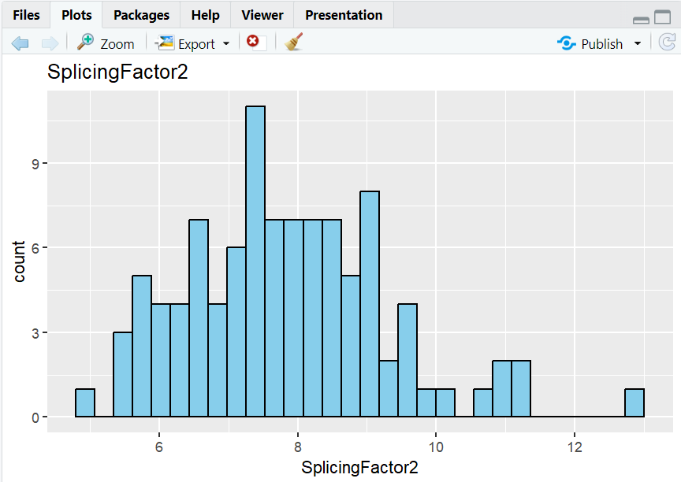
2. DATA VISUALIZATION
The following histogram shows the Distribution of splicingFactor2 features.
Here we have a lesser count of splicing factor when its value increases.

Slide 11
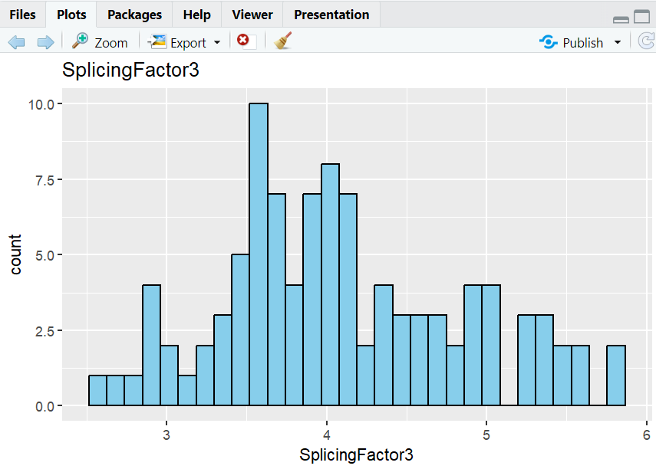
2. DATA VISUALIZATION
This is the Distribution of splicingFactor3 features in a histogram.
Here have normalized the count of the splicing factor when its value increases.

Slide 12
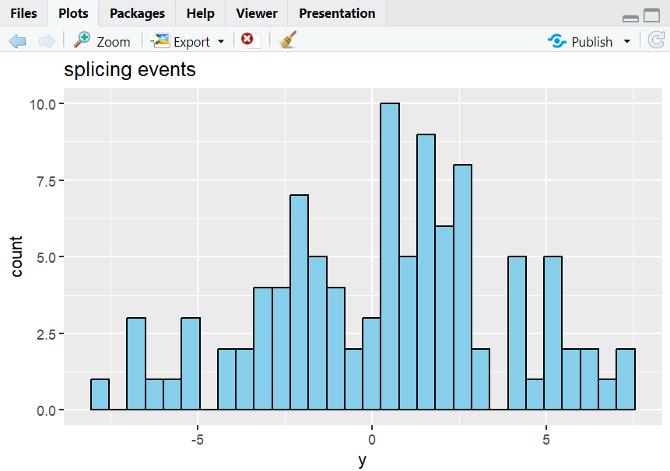
2. DATA VISUALIZATION
The below histogram shows the Target variable values distribution.
Here we can see its greater count of value at the middle of the range of the given value of the target variable.

Slide 13
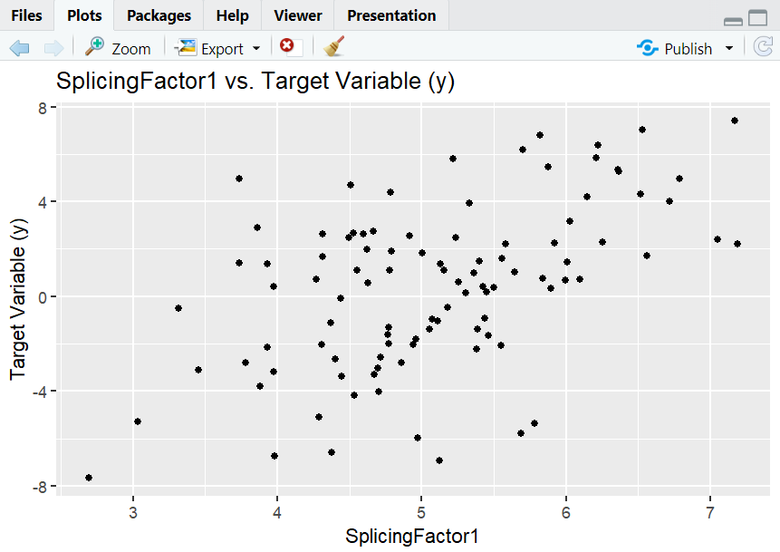
2. DATA VISUALIZATION
Here we created graphs to visualize the relationships between each
splicing factor and the splicing event
This is the Scatter plot that is In between the splicing factor1 and the target variable.
It suggests that the relationship is linear in nature. As the value of the splicing factor increases the target variable
value also increases

Slide 14
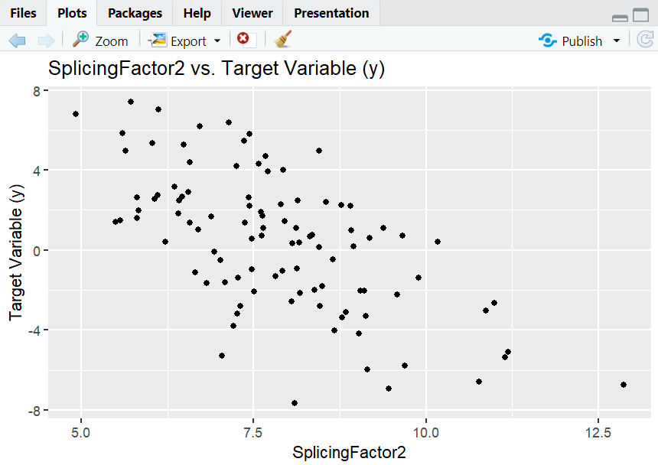
2. DATA VISUALIZATION
This is also the Scatter plot that’s In between the splicing factor2 and target variable.
It suggests that the relationship is linear in nature. As the value of splicing factor increases the target variable
value decreases.

Slide 15

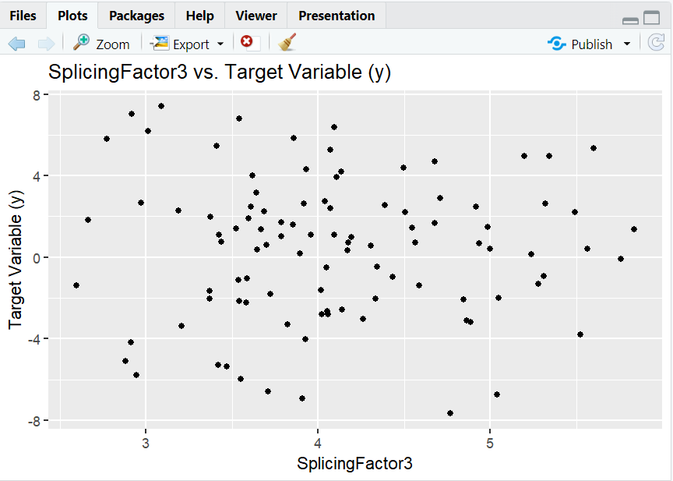
2. DATA VISUALIZATION
The last Scatter plot is In between the splicing factor3 and target variable.
It suggests that the relationship is not linear in nature. The data points are scattered across the graph.

Slide 16
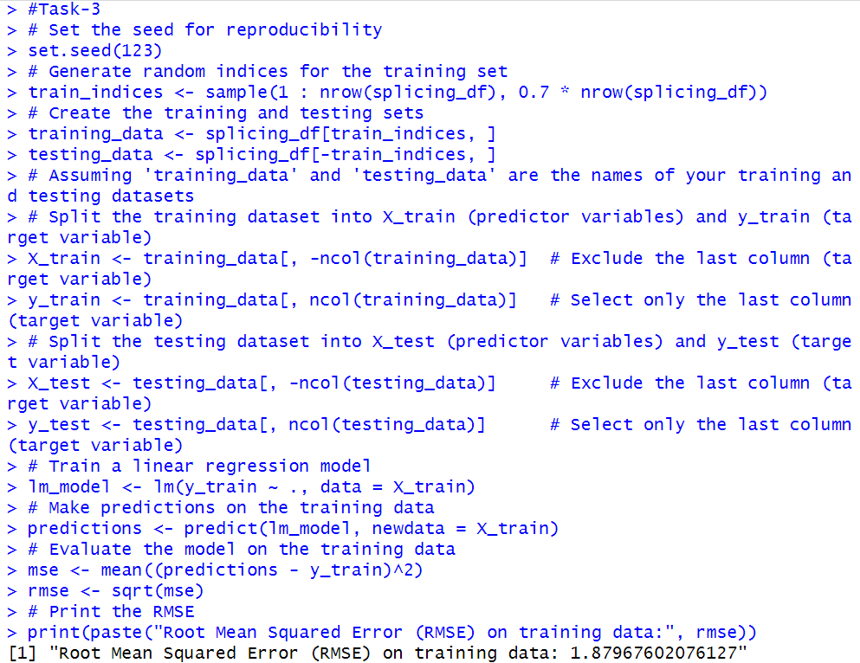
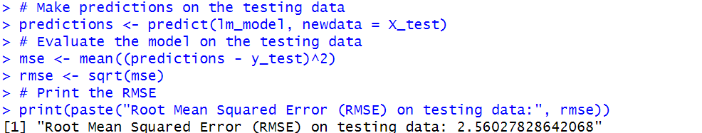
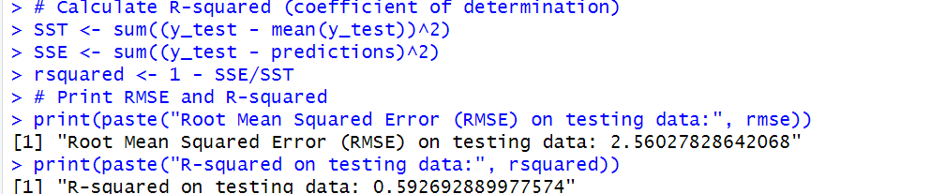
3. PREDICTIVE MODELING
By seeing the Root mean squared error we can conclude that our testing data point’s predicted values are 2.56 units away from the actual values.
Our linear Regression model performs very well in predicting the output.

Slide 17
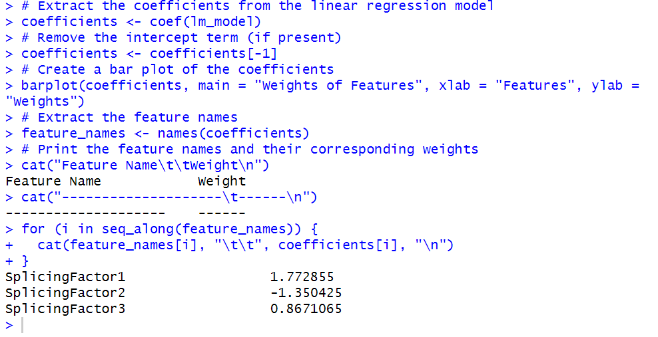
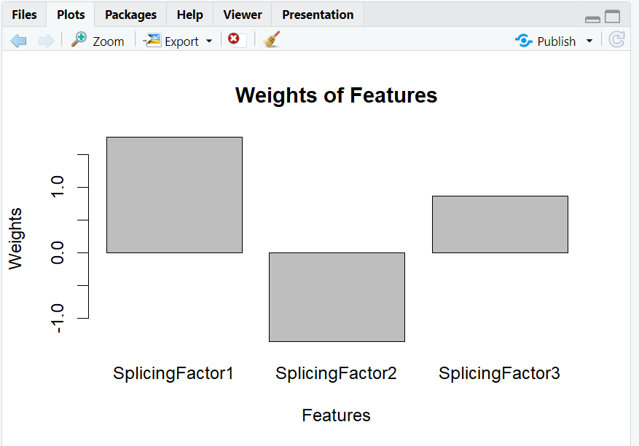
3. PREDICTIVE MODELING
The weights of each parameter are represented by the bar plot,
which facilitates simple comparison of their relative importance.
With the highest positive weight, SplicingFactor1 is predicted to
have the most positive correlation with the expected result.
SplicingFactor2's negative weight suggests a poor correlation
with the result.
SplicingFactor3 is weaker than SplicingFactor1 but has a favourable
Weight- It has a less noticeable effect than SplicingFactor1.

Slide 18
3. PREDICTIVE MODELING
Interpretation:
The influence of features is represented by weights: The weights (coefficients) in the linear model show the relative contribution of each feature to the expected result.
Features with positive weights have a positive correlation with the result, whereas those with negative weights have a negative correlation. Positive weights rise, and negative weights fall.
Greater absolute weight equals stronger impact: A feature's effect increases with its absolute value.
Insights
By, the model we get to know that splicing factor1 has a large impact on the splicing event. It had a positive impact on the target variable.
The other two features have opposite impacts on the splicing events.

Slide 19
4. CONCLUSION AND RECOMMENDATONS
All the key findings are displayed above. In the respective sections.
Prior feature:
The coefficients (weights) plot of the above gives us a certain idea.
The splicing factor1 weighs approximately 1.773. since it’s positive in nature and indicates a positive relationship with the target variable.
The splicing factor 2 had a negative relationship with the target variable.
The last feature had a positive relationship with the target variable.
Comparing the absolute values of the weights, we can see that SplicingFactor1 has the strongest relationship with the target variable among the three features, as it has the largest absolute weight.
Recommendation:
Any model requires a large amount of data points to learn general patterns or trends in those data points. Always try to get more and more data points.
We can use some other algo to get the result.

Slide 20
THANK YOU

